Slide 1

Intro To Python
Code Ninjas Crestwood

Slide 2

Today’s Overview
Hello everyone! Today we will learn about:
Python Basics
User Inputs
Booleans and if-elif-else statements
Lists
for and while loops
Functions

Slide 3

Cool Projects!
Along the way, we’ll use our new skills by doing some hands-on Python projects!
Mad Libs!
Rock-Paper-Scissors
Number Guesser (Final Project v1)
Calculator (Final Project v2)
Hangman (Final Project v3)

Slide 4

Introductions
Let’s all introduce ourselves!
Name
Age
Coolest coding project you’ve ever made

Slide 5
WingIDE
Do this part later
Introduce how to use WingIDE, including features like the interactive Python section, Run code, and how to save files.
Wait to see how the IDE appears on the Dojo computers before making the slide(s)

Slide 6
Python Basics
Strings, integers, and the print statement

Slide 7
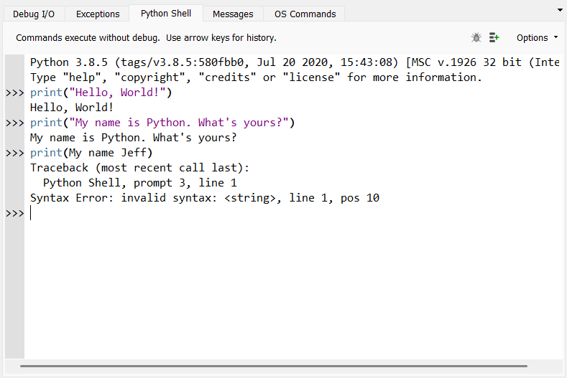
Hello, World!
To print something onto our screens, we need to use the print function.
We also need to put the text that we want to print between “quotation marks”
If we forget the “quotation marks”, we will get an error

Slide 8
Strings
“Hello, World!”
When we wrap text between “quotation marks”, we create something in Python called a string
A string is just a fancy word for text
Usually, the print function can only print strings
“Code Ninjas is the best”
“abc123xyz”

Slide 9
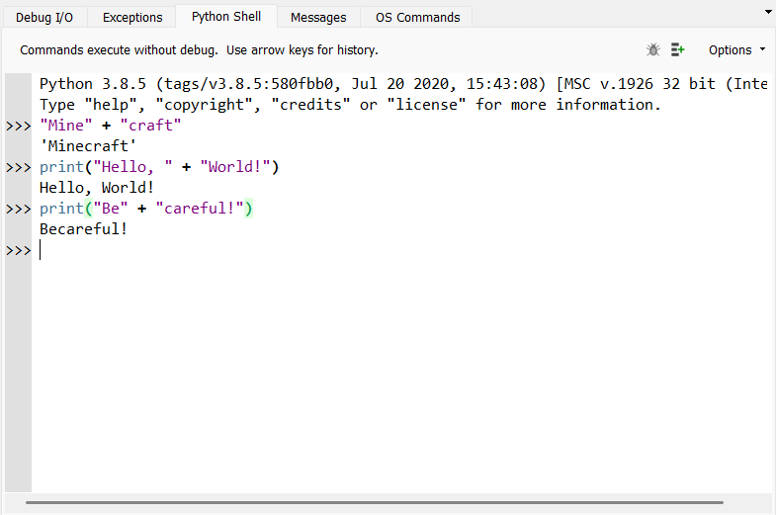
Combining Strings
To put two strings together, we can just put a plus sign (+) between the two strings!
You can also use a plus sign to put two strings together inside of a print function.
Be careful! When you’re combining two strings together, make sure you include a space at the end of the first string!

Slide 10
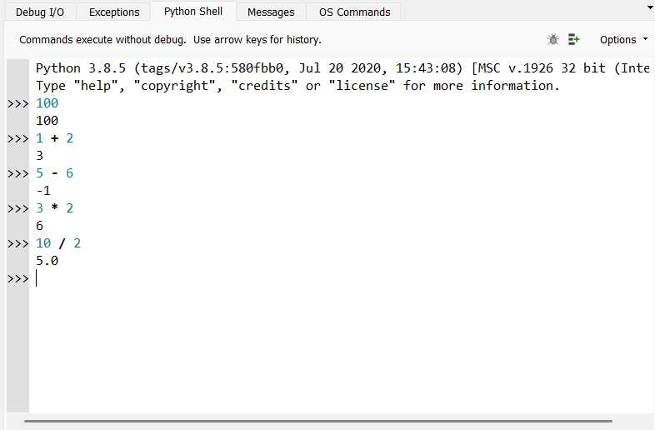
Integers
We can also use integers in Python!
Integer is just a fancy word for a whole number like 1, 15032, or -10.
With integers, we can do mathematical calculations like addition (+), subtraction (-), multiplication (*), and division (/).

Slide 11
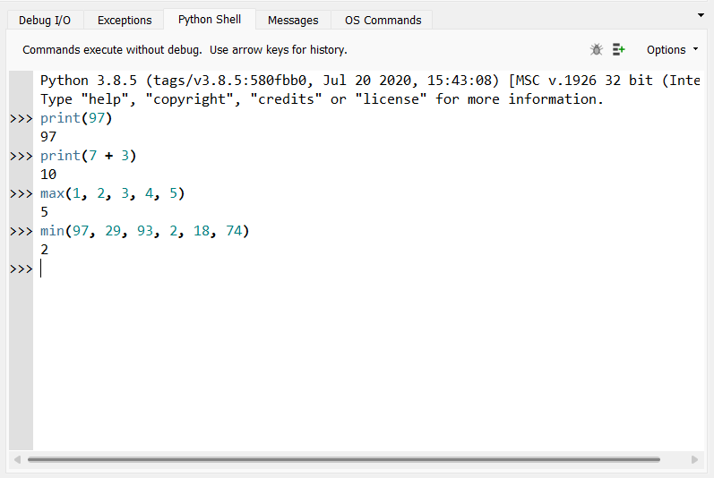
More About Integers
We can also print integers and entire mathematical operations with the print function.
We can find the maximum of a bunch of numbers by using the max function.
We can also find the minimum of a bunch of numbers by using the min function.

Slide 12
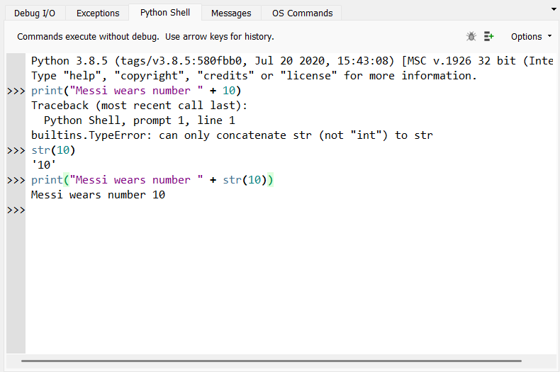
Combining Strings and Integers
If we try to combine a string and an integer by just putting a plus sign (+) between them, we get an error
To avoid this, we need to convert the integer to a string by using the str function on the integer
Now, we can put a plus sign between them and combine the string and integer!

Slide 13
Summary: Python Basics
Python has strings (“text”) and integers (whole numbers).
We can print both strings and integers on the screen using the print function.
We can combine strings using the plus sign (+)
We can do math on numbers using +, -, *, and /
We can combine strings and integers by converting the integer to a string first
str(50)

Slide 14
Variables
Assigning variables and how to use them

Slide 15
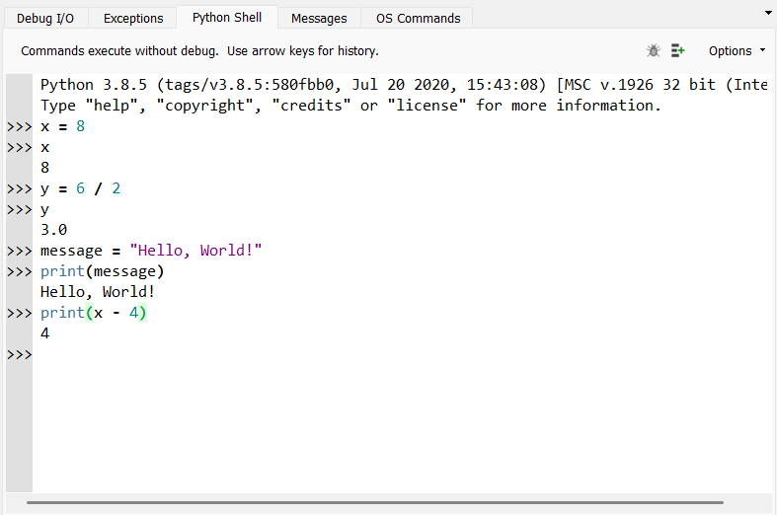
What are variables?
Variables are used to store data and give it a name so that we can use it later
They can store almost anything in Python, including strings, integers, lists, and Booleans
We can assign a value (or the result of a calculation) to a variable by using the equals sign (=)
Structure: variable = value

Slide 16
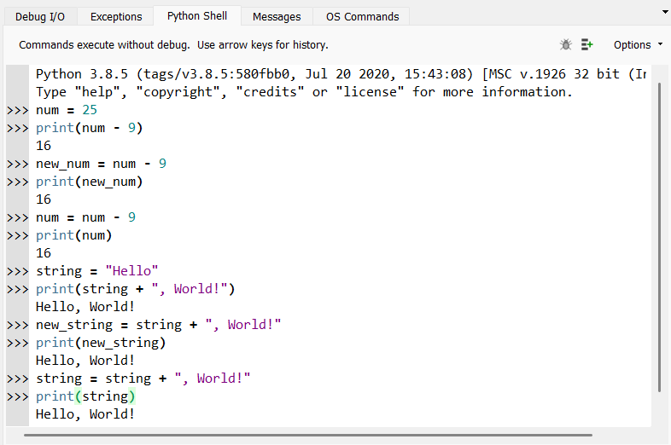
How can we use variables?
After assigning a variable, we can use it anywhere else in our program by using its name
You can use a variable to perform a calculation
You can use a variable to compute another new variable
You can also update variables by assigning it to a calculation with itself

Slide 17
Summary: Variables
Variables can store almost any type of data and give it a name so that we can use it later in our programs
We can assign a value or a computation result to a variable by using the equals sign (=)
variable = value
After assigning a variable, we can use it again in our program simply by using its name
We can use variables to perform computations, compute new variables, or update variables by assigning them to a computation that includes itself

Slide 18
Inputs
The input function, program customizations, and integer conversions

Slide 19
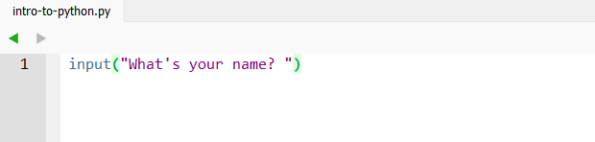
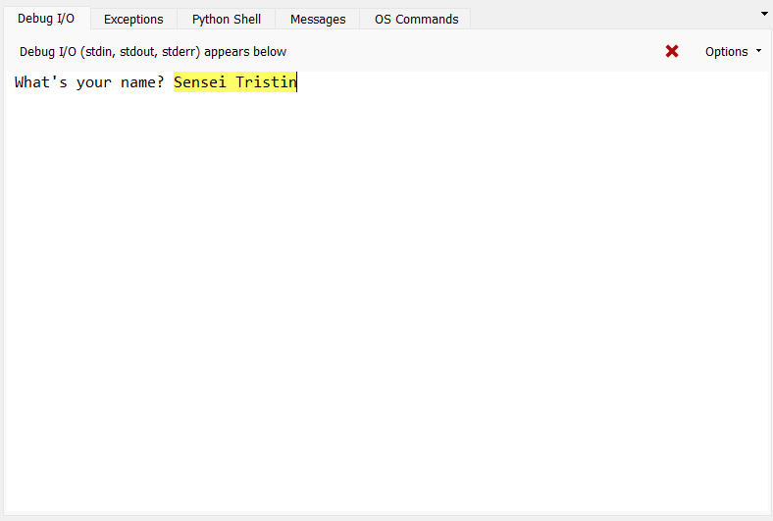
The input function
What if we want to get information from the user to use in our program?
We can use the input function!
We type the question or prompt that we want to ask inside the function.
When we run our program, this prompt will be printed on the screen for the user to answer.
Remember to include a space at the end of your prompt!

Slide 20
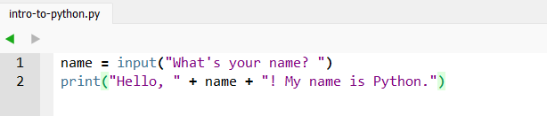
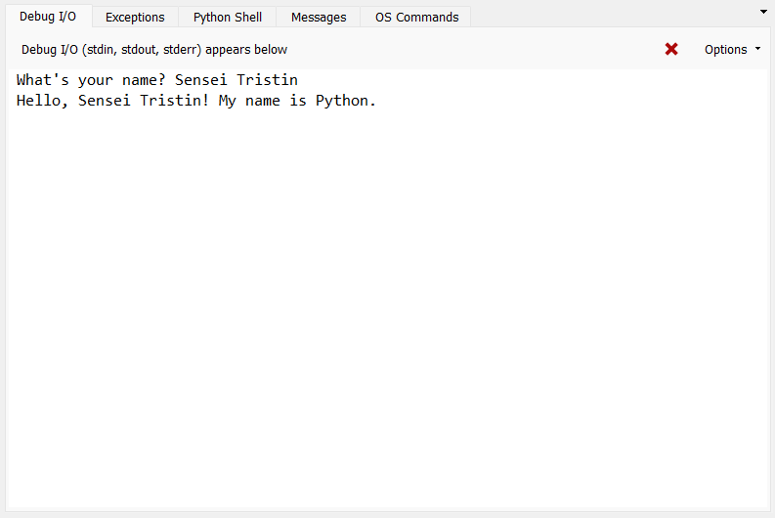
Storing and Using Inputs
Usually, we want to use player inputs in our programs. This can customize our program’s behaviour!
To use player inputs, store it into a variable by using an assignment.
After storing it into a variable, we can use that variable just like any variable that we’ve already learned about!

Slide 21
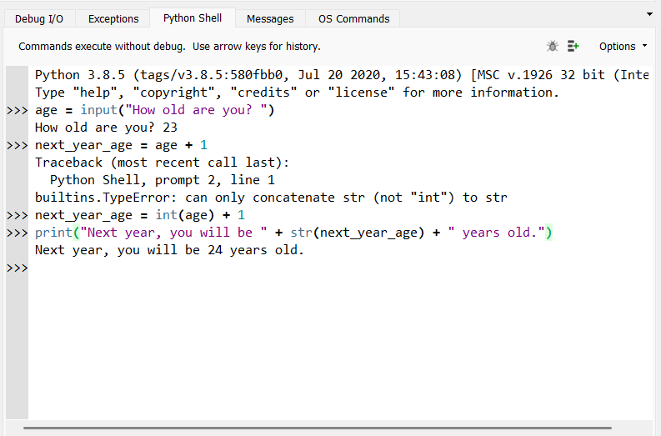
Number Inputs
We can also get number inputs from users.
However, we cannot use these inputs as numbers immediately! Inputs will always be stored as strings.
To use an input as a number, we need to convert the string into an integer by using the int function on the string.

Slide 22
Summary: Inputs
We can use the input function to ask the user to input that you can use to customize the behaviour of your program.
To use the player’s input, remember to store it in a variable!
If you want to use a number that your player inputted, remember to convert the input to an integer first by using the int function!

Slide 23
Project Time!
Mad Libs!

